Slide 1


Hartford Bank Loan Application Improvement Process

Slide 2
Agenda
Our Team
Company Overview
As-Is Process
Pain Points and Enablers
To-Be Process
Data Model
Database Demo
Conclusion and Next steps

Slide 3




03
Rachana Wagle
John Fowler
Anisha Biswal
Madhusree Chowdhury

Slide 4
Hartford Bank Overview
Located in Connecticut, serves individual customers and small and middle-market businesses with financial products and services.
Serves approximately half a million consumers and small business clients with its various loan products with the loan acceptance rate of 54%
Hartford bank stock (NYSE: HTF) is listed on the New York Stock Exchange.
Loan Applications
Verification of Applications
Review of the customer details
Loan Request

Slide 5
Bank Loan Application Improvement Process
A collection of interrelated tasks, initiated in response to an event achieving a specific result for the customers and the other stakeholders.
Loan Applications
Verification of Applications
Review of the customer details
Approved Loan Request
A customer applies for loan in Hartford bank
Loan gets approved
Loan Applicants
Hartford bank
Share-holders
Interrelated Tasks
Event
Result
Customer
Stakeholders

Slide 6
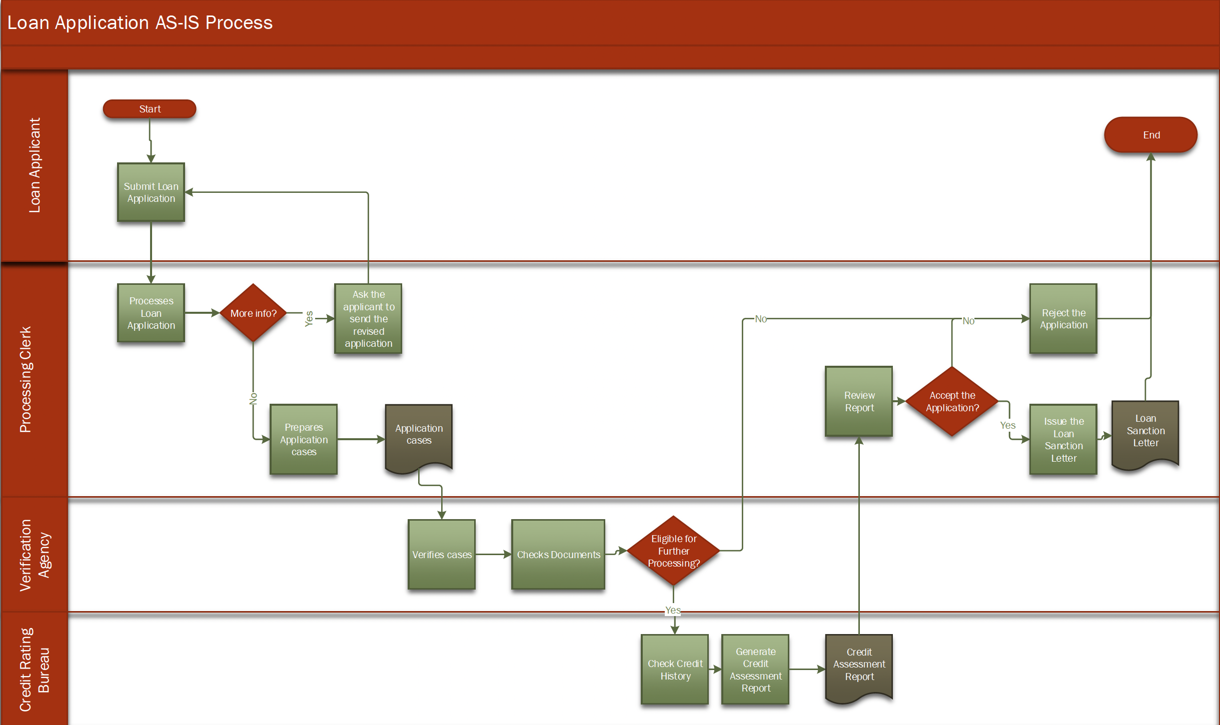

Slide 7
Pain Points and Enablers
Low count of customer
Less loan acceptance rate
Not enough competitive in market
Loss of potential customers,
Enablers: Policies and rules.

Slide 8
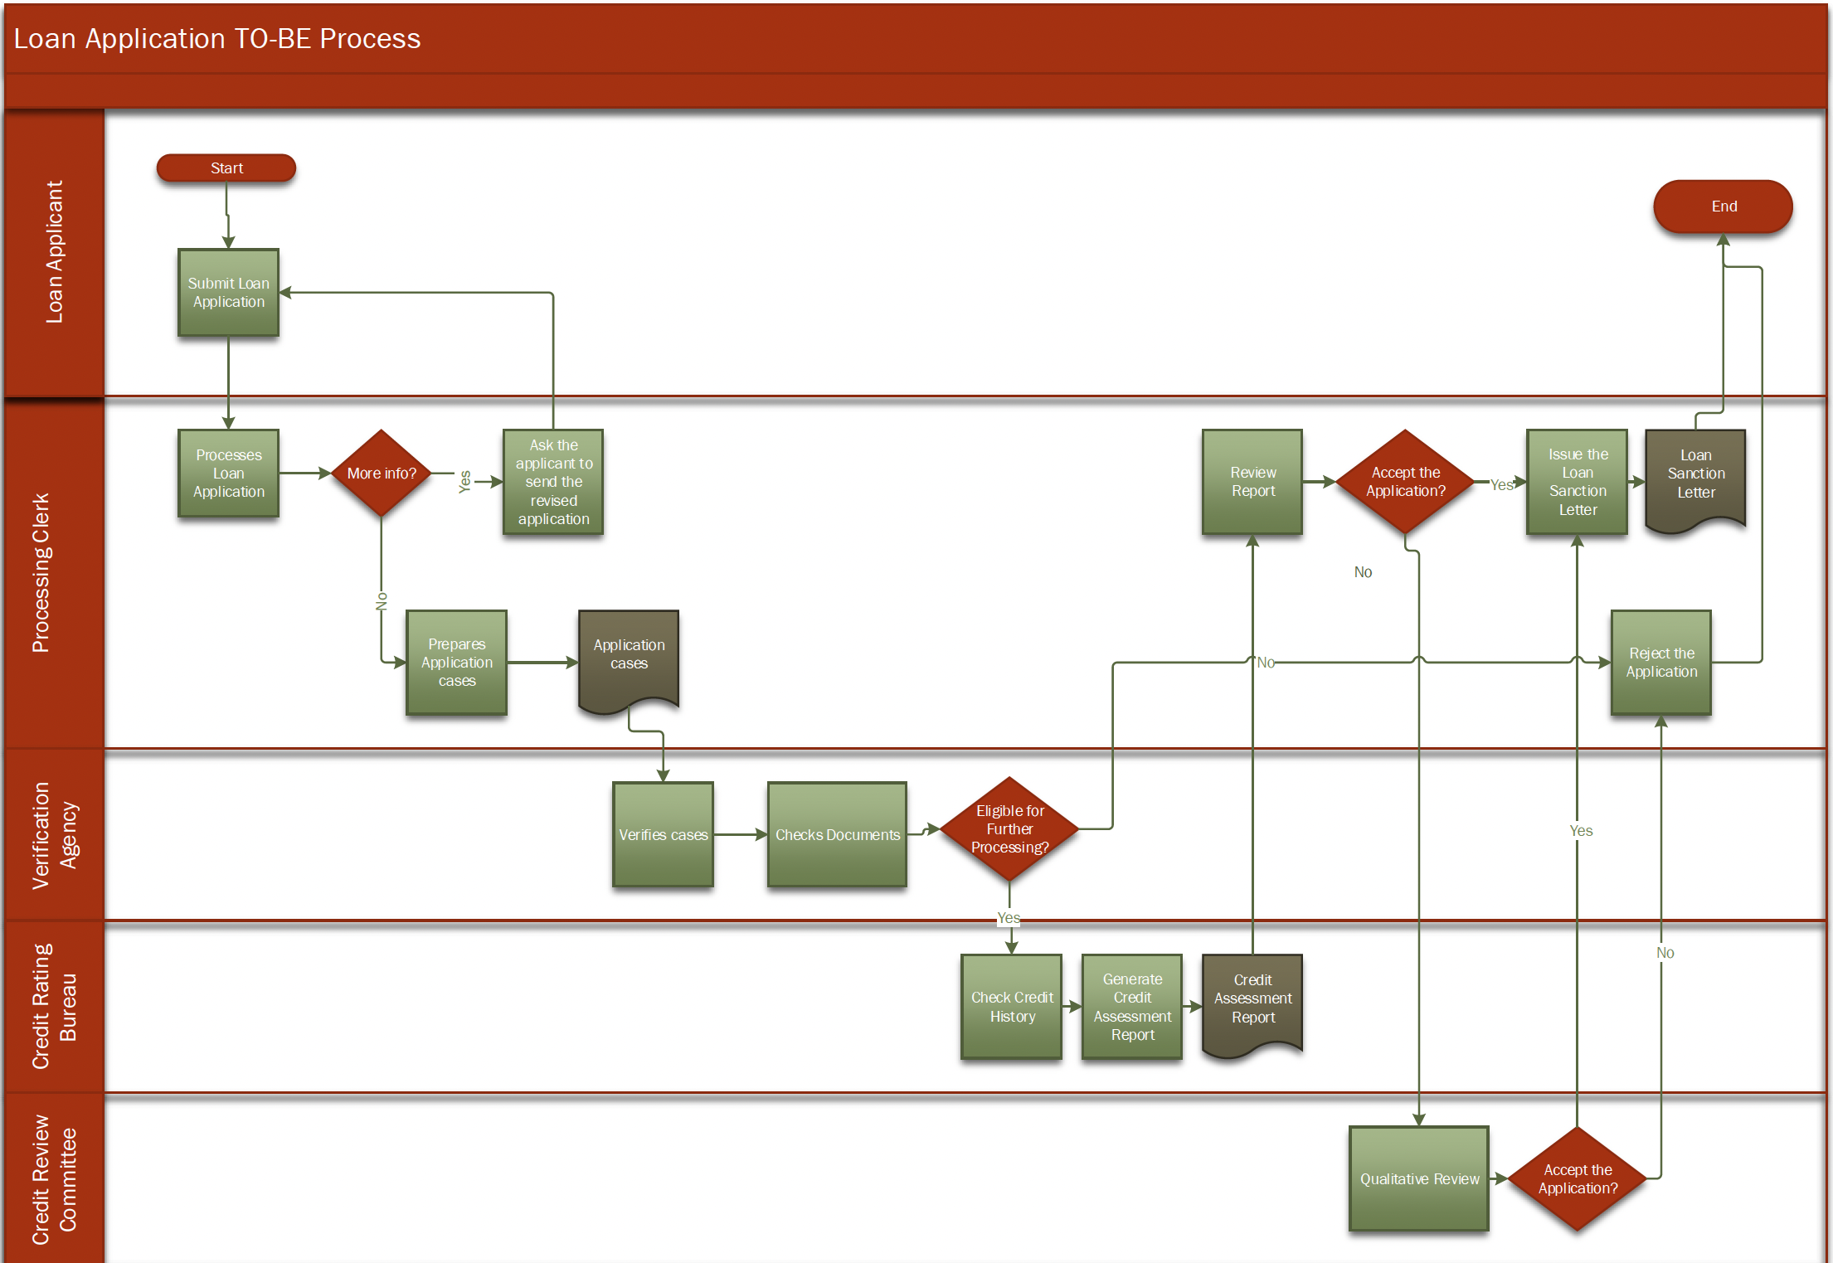

Slide 9
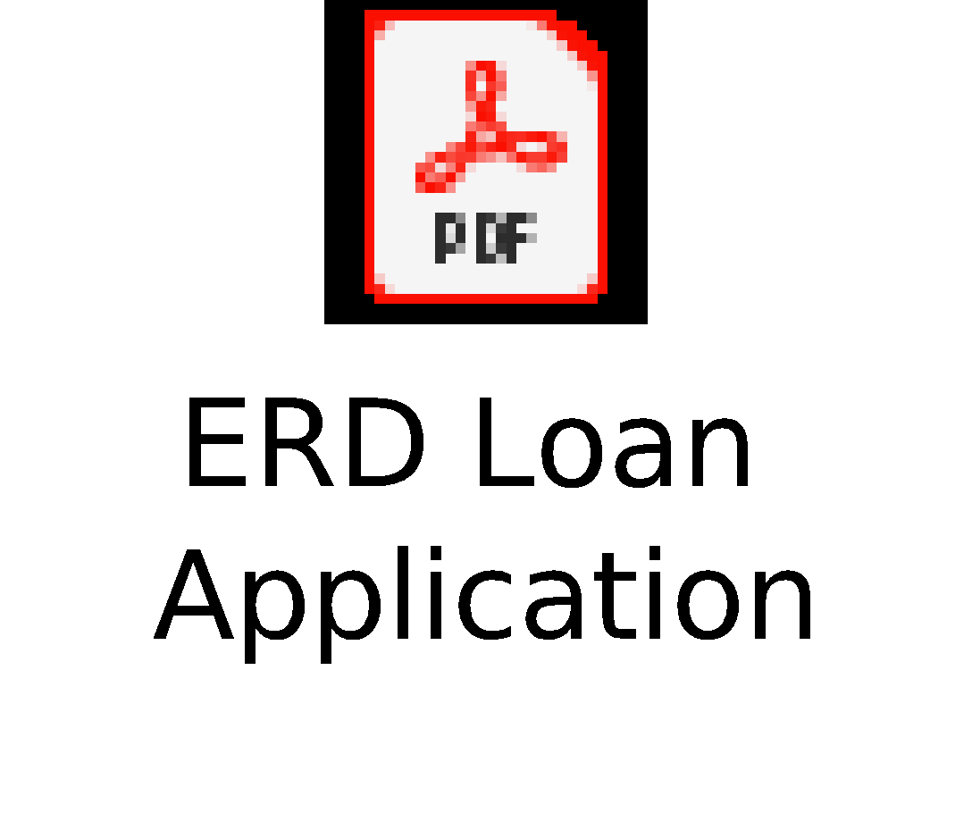
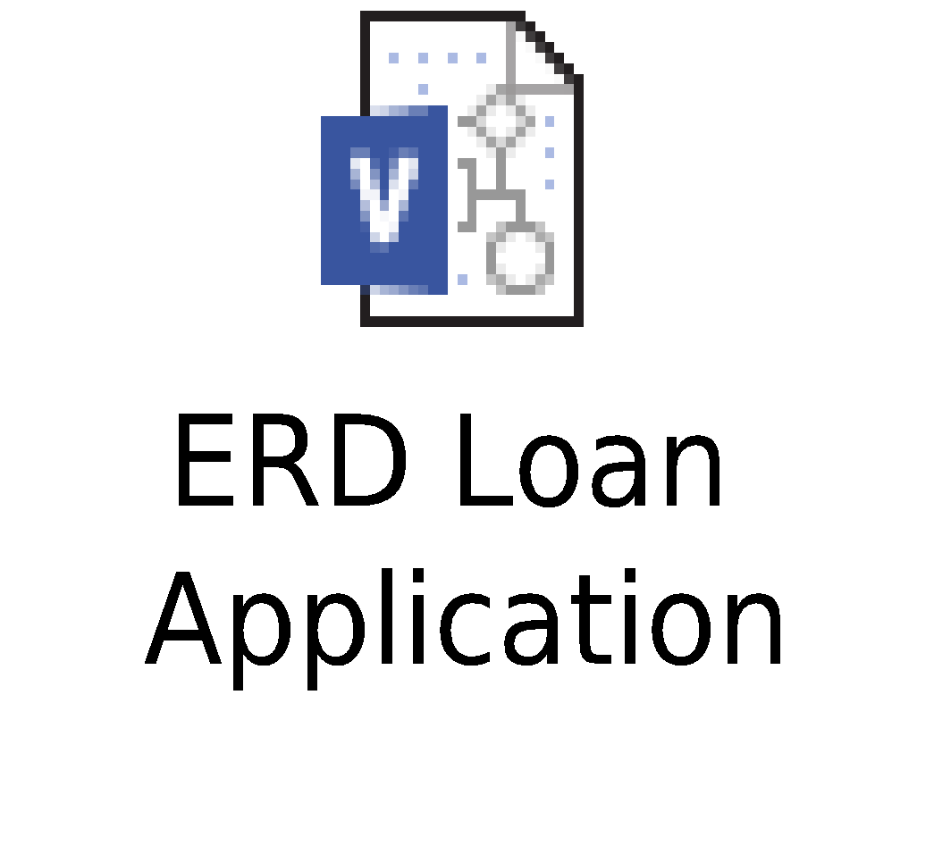
Loan Application ERD
Agents
Verification Agency
Cases
Processing Clerk
Employs
Assigned to
Creates
Processes
Loan Application
Loan Request
Credit Rating Bureau
Approves
Rejects
Approves
Rejected Applications
Credit Review Committee
Get Re-evaluated

Slide 10
Database Demo
Multiple systems are connected through our database.
Applicant information
Verification Agency Information
Credit Rating Bureau and Committee Information
This allows us to investigate a request as it moves through the system.
We can see where people may fail in the process
Can also observe individuals working for organizations we partner with in the process

Slide 11
Business Questions
Finding statistical information on approved applicants, and the number of approved applicants by Credit Rating Bureau
Distribution of cases to verification agents
Finding count of applicants approved by Credit Review Committee but not the initial bureau to find potential areas of improvement
Predict an individual's likelihood of being approved for a loan
Find applicants with loan amounts above the average ticket size for optimizing targeting strategies

Slide 12
Cloud Database Management System
The cloud database system:
Was conceived for the purpose of online data management by using a variety of distributed servers
Is far cheaper than that of maintaining an actual server, wherein a lot of other applications are necessary
Will make customer information analysis simple and convenient
Will emphasize on easy access to files and data .If freak accidents happen, there is no reason for you to worry since all pieces of information are safely kept.

Slide 13
Conclusion
The Bank can evaluate thousands of applications quickly and impartially. Decisions on mortgages, car loans or extended limits on credit cards can be handled in days or even minutes.
This reduces the possibility for human error via automation
The Bank has now built a robust credit scoring database management system to forecast loan performance; manage credit risk; predict the customer's ability and willingness to repay as scheduled, forecast delinquency, bankruptcy rates.
This system deciphers patterns in the credit histories of groups of individuals as reflected in credit bureau records

Slide 14


Slide 15
Thank You!

